Slide 1

archi-tec
allied

Slide 2

archi-tec
allied

Slide 3
archi-tec
allied

Slide 4

archi-tec
allied

Slide 5
INFORMATION
COMPANY NAME:- archi-tec allied
PRINCIPAL ARCHITECT:- S.RAVIKUMAR (B.ARCH)
Head office :- #1, masilamani, street, t.Nagar,
chennai – 600 017
BRANCH OFFICE :- 35c, jayadurga nagar, jharapada, bhoomikal,
bhubaneshwar, odisha 751010
mail:- architecallied@gmail.com
landline:- 044-4206 8884
phone:- +91 94441 17173
Font used “Century Gothic”

Slide 6


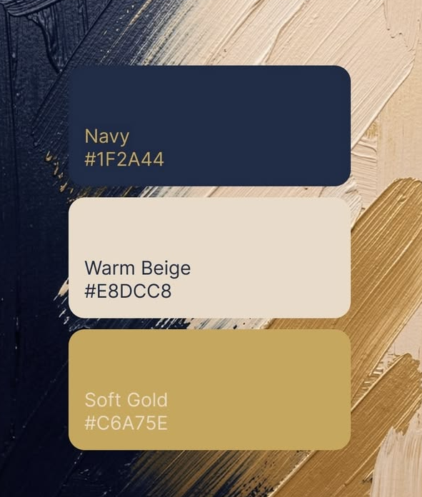
COLOR PALETTE

Slide 7



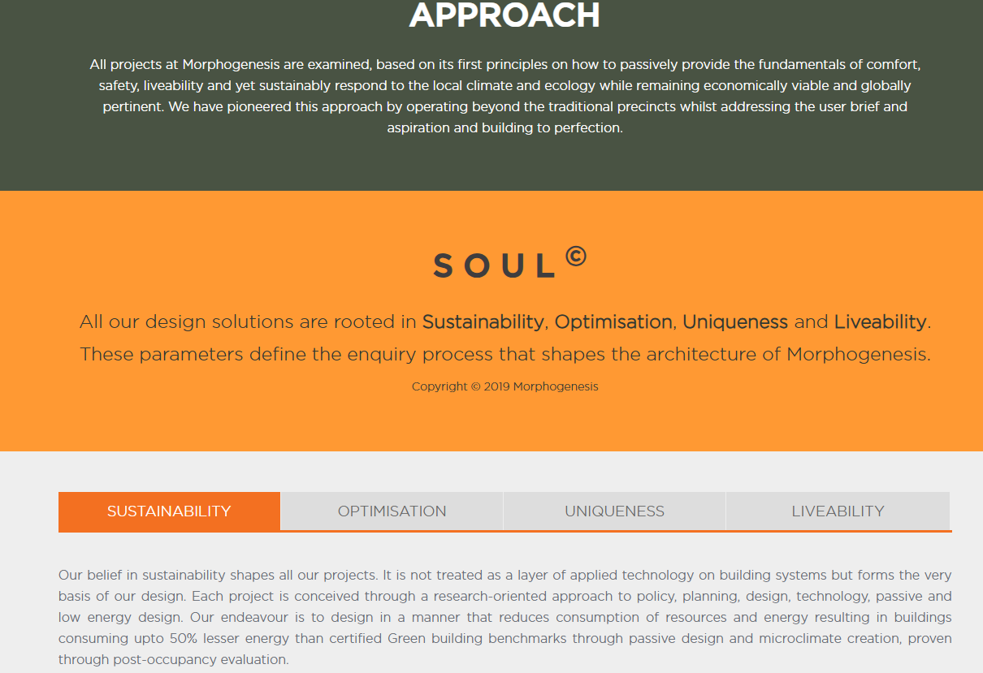
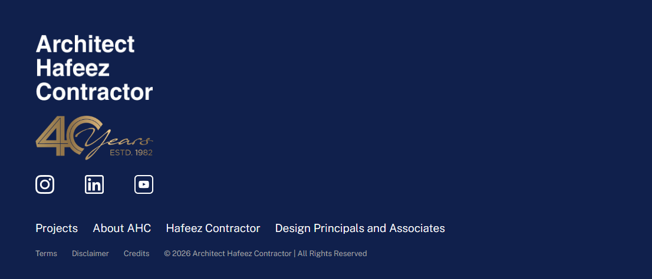
ABOUT US (INTRODUCTION)
Who we are
Our clients
Our people

Slide 8





OUR CLIENTS

Slide 9





OUR CLIENTS

